Slide 1

Qube
Group 16: Tarun Prakash, Agathiya Tharun, Manav Jhaveri, Aarya Deb

Slide 2
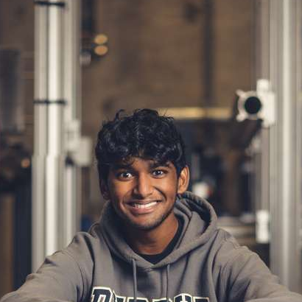
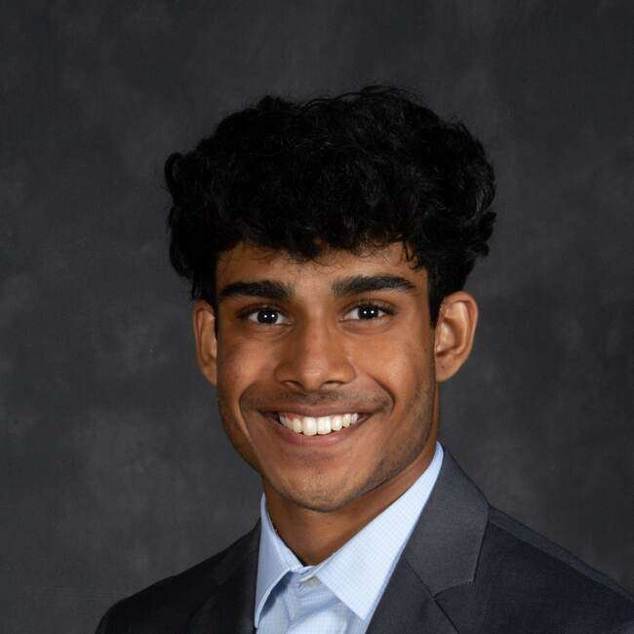
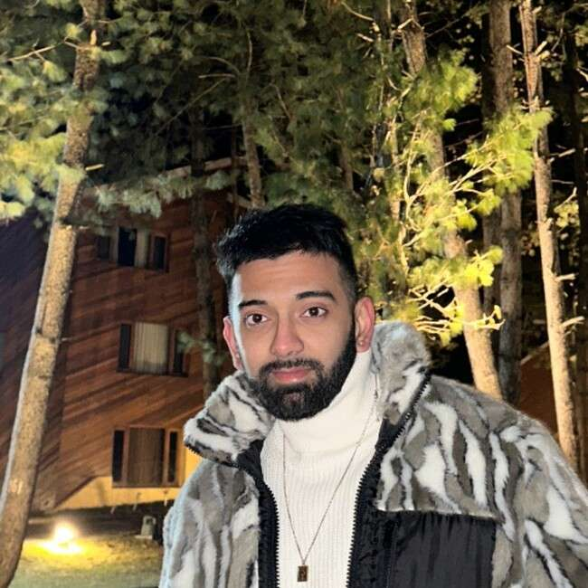
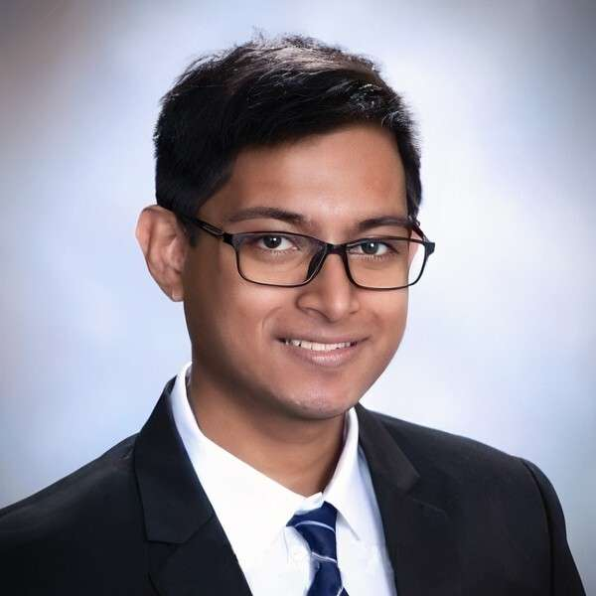
Team
Tarun Prakash
Agathiya Tharun
Manav Jhaveri
Aarya Deb

Slide 3
The Problem
The average person will spend 10 years of their life at a desk
Productivity often decreases
Easy to get distracted; smartphones
No alternative to quitting cold turkey - (NoPhone – Shark Tank)
People can easily feel lonely
Notes:
- everyones experienced procrastination at their desk after long hours
- people want an assistant and a companion
- no good way to ease off using your phone

Slide 4
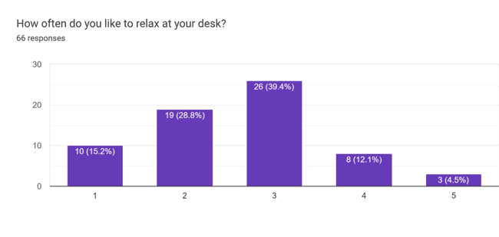
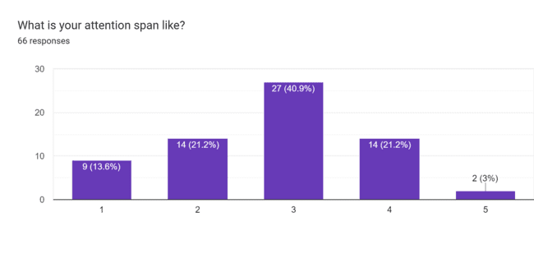
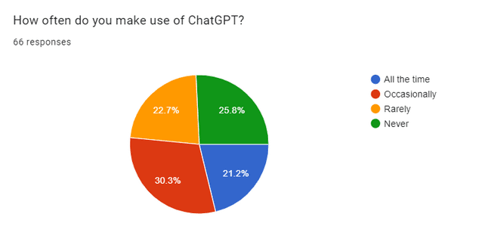
Customer Survey
Struggle maintaining focus
Highly focused
Very often
Seldom
Notes:
- 75% have difficulties focusing
- 84% relax at their desk
- almost 75% use gpt

Slide 5
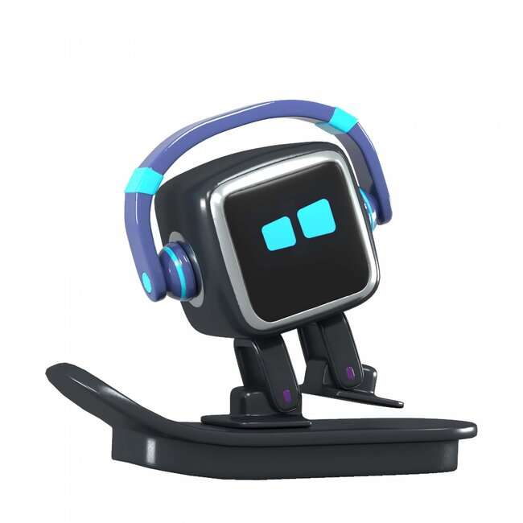
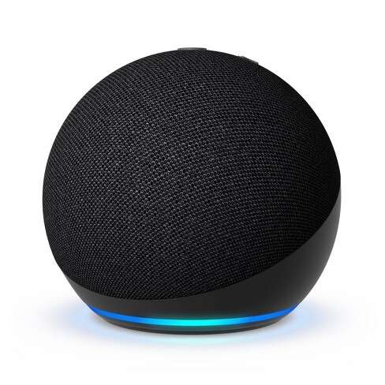
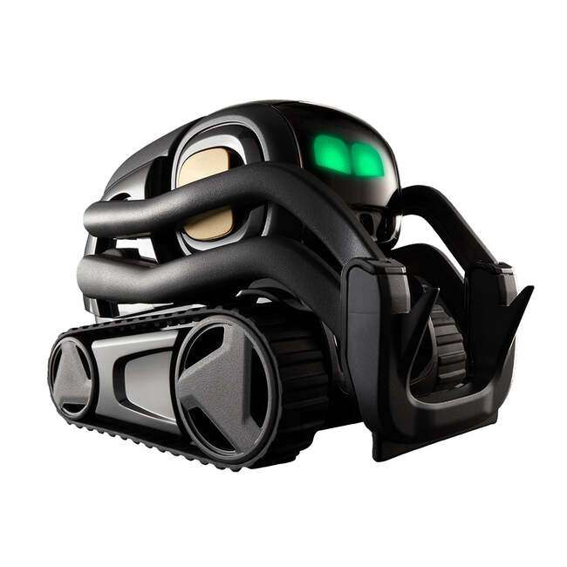
Competitors
Emo - $300
Emotional pet, not an assistant
Alexa - $25
Assistant, not a friend, No GPT support
Vector - $400
Friend and assistant but expensive
Notes:
- ai pets have too many unnecessary features and can even be needy at times (like a real pet). None are simplistic

Slide 6
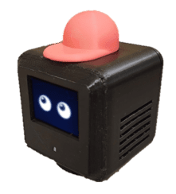
Our Solution
A multifunctional tabletop assistant and companion
Environment-dependent adaptive personality (EDAP)
Physical embodiment of GPT/AI with IoT
Motion-enabled toy and fidget
Customizable
Portable
Notes:
- alternative to quitting cold turkey as it improves productivity without a phone and helps minimize screen time
- playful, useful, monitoring, funny. Different voices
- playful motion tracking
- customizable: variety of accessories, comes in many shapes and sizes
- leverages a variety of outputs to interact with the user including: motion, audio, video output

Slide 7
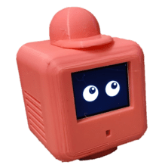
Value proposition
Source of education and entertainment for users
Potential to be a platform
commitment to user data privacy
Sustainable and carbon neutral
Affordable (<$30)
Notes:
- 1st bullet: middle ground between friendliness of vector and usefulness of alexa
- platform that promotes app development amongst a community of developers. Utilizes a variety of sensors

Slide 8
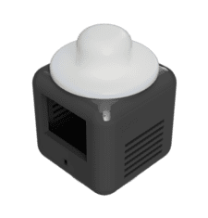
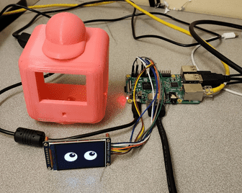
Product Hardware
Raspberry Pi
LCD Display
Speakers
Microphone
Gesture Sensor
Button
Notes:
- plan to integrate a motor whose encoder is another sensor input

Slide 9
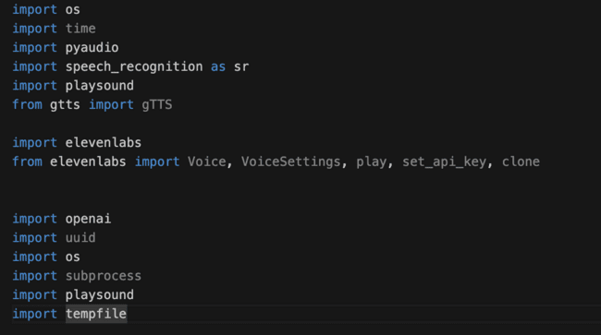
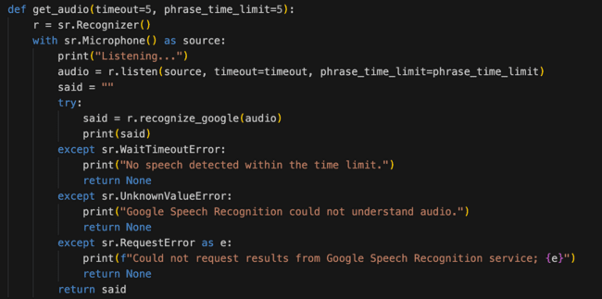
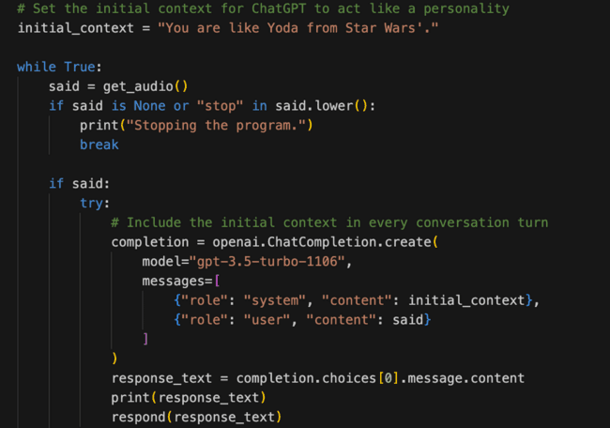
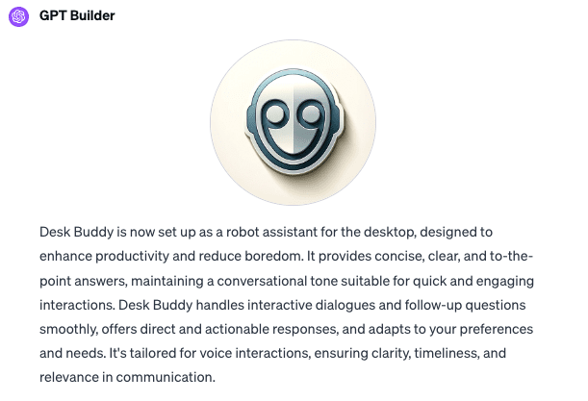
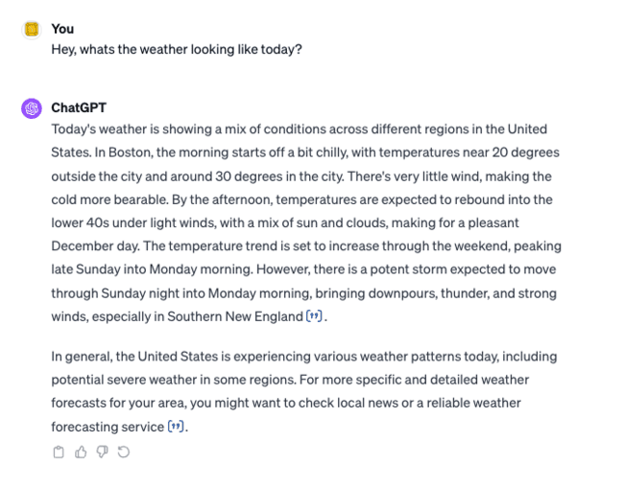
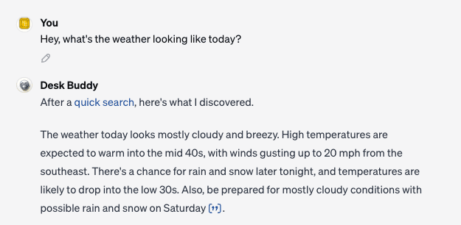



Product (Software) - Manav
GPT Integration
Notes:
OpenAI API Integration: Utilized OpenAI's API to empower the functionalities of our cube.
Voice to Text Conversion: Implemented Google's speech recognition technology for converting voice inputs into text.
Text to Voice and Voice Cloning: Used Eleven Labs' advanced tools for text-to-speech conversion and to clone specific voice personas.
Custom GPT Development: Developed a custom version of GPT due to the original ChatGPT's limitations in conversational context and verbosity.
Focus on Brevity and Fluidity: The custom GPT is designed to deliver quicker, shorter, and more fluid responses.
Comparison with ChatGPT: Demonstrated differences between standard ChatGPT responses and our custom GPT, highlighting the latter's conciseness and directness.

Slide 10
Conversation AI

Slide 11
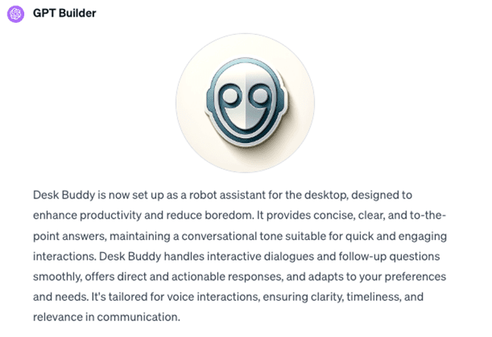
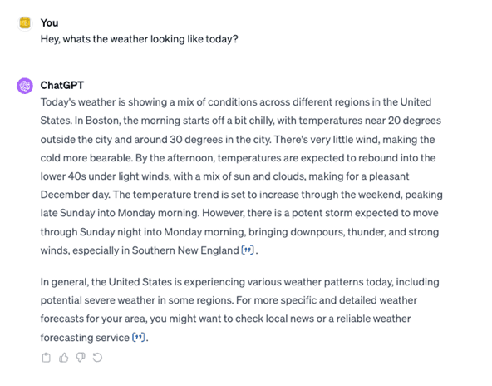
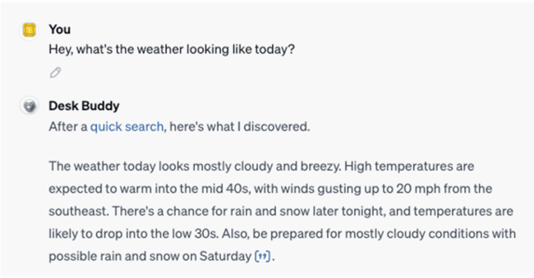
GPT AI

Slide 12
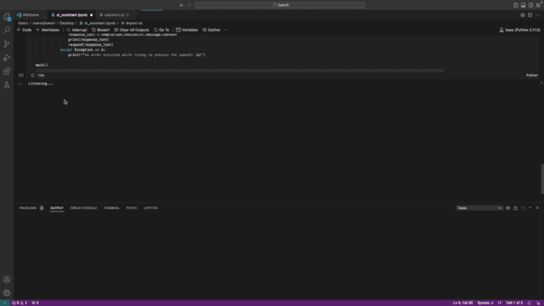
Software Demo

Slide 13
Software Demo

Slide 14
Business model
MSRP: $30
Optional Monthly Subscription: $5
Access to GPT-4, even during peak times
Faster response times
Priority access to new features and improvements
Platform: Marketplace
Voice Actors: $5
Add-Ons: $5
Future Apps: Commission-based

Slide 15
Market
Target demographic includes:
Ages 10+
Education and STEM-learning market
Early-tech enthusiasts
Kids/adults wanting an affordable smart companion
Roboticists, researchers, and software developers

Slide 16
Preliminary User Feedback
Positive:
Amiable
Highly customizable
Low cost
Negative:
Response time
Limited motion
Cheap material

Slide 17

Thank You!

